Slide 1
Run-Time Power Gating of On-Chip Routers Using Look-Ahead Routing
Hiroki Matsutani - Michihiro Koibuchi
Daihan Wang - Hideharu Amano
(Keio Univ, Japan)

Slide 2
Outline
On-Chip Router
Architecture
Power consumption
Runtime power gating of routers
Overheads
Look-Ahead sleep control
Evaluations
Performance penalty
Compensated sleep cycles
Leakage reduction

Slide 3
On-Chip Router: Architecture
5-input 5-output router (data width is 64-bit)
Two virtual channels
(64-bit x 4 x 2)
ARBITER
X+
FIFO
X+
X-
FIFO
X-
Y+
FIFO
Y+
Y-
FIFO
Y-
5x5 XBAR
CORE
FIFO
CORE
HW amount is 34 kilo gates and 64% of area is used for FIFO

Slide 4
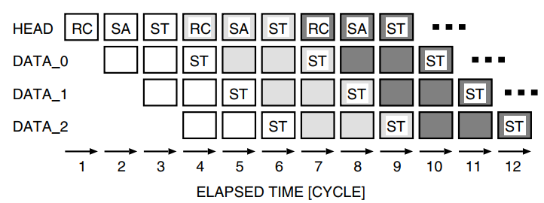
On-Chip Router: Pipeline
A header flit goes through a router in 3 cycles
RC (Routing Computation)
SA (Switch Allocation)
ST (Switch Traversal)
E.g., Packet transfer from router A to C

Slide 5
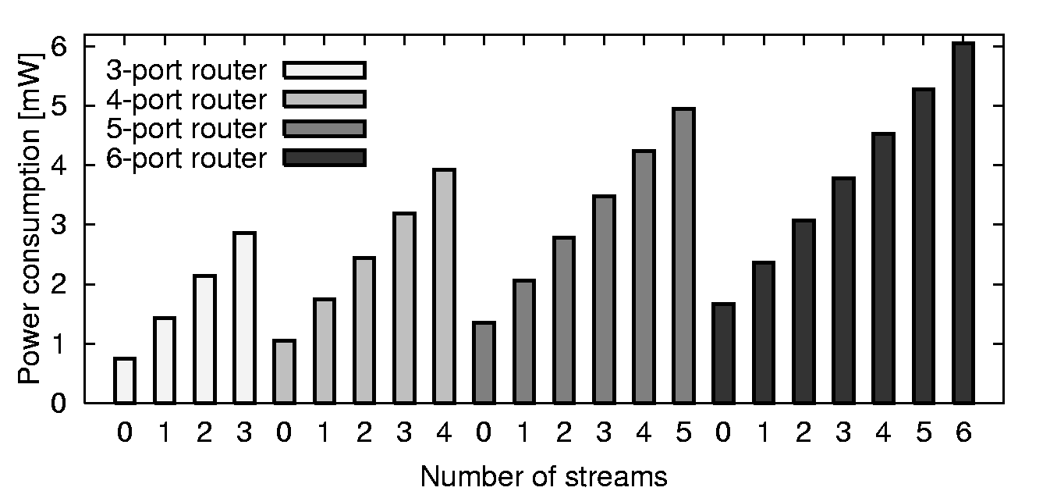
On-Chip Router: Power consumption
Place-and-routed with 90nm CMOS
Post layout simulation at 200MHz
Power consumption of a router when n ports are used [mW]
Notes:
A router consumes more power as the router processes more packets

Slide 6
Outline
Network-on-Chip (NoC)
On-Chip Router
Architecture
Power consumption
Runtime power gating of routers
Basic sleep control
Look-Ahead sleep control
Evaluations
Performance penalty
Compensated sleep cycles
Leakage reduction

Slide 7
Basic Sleep Control
Basic Routing:
Router i calculates the output port of Router i
Basic Sleep Control
=> performance penalty due to the wake-up delay
depends on how early the new requests can be detected

Slide 8
Look-Ahead Sleep Control
Look-ahead Routing:
- Router i calculates the output port of Router i+1
=> To mitigate the wakeup delay and short-term sleeps
Five-cycle margin until packet arrival
R0
R1
R2
RC
SA
ST
RC
SA
ST
RC
Look-Ahead:
R2 detects a packet arrival when the packet arrives at R4
ST
ST
R3
R4
R5
ST
Packet will arrive after two hops
R6
R7
R8
ST
Router 4
Router 5
Router 2
Look-ahead can eliminate a wakeup delay of less than 5-cycle

Slide 9
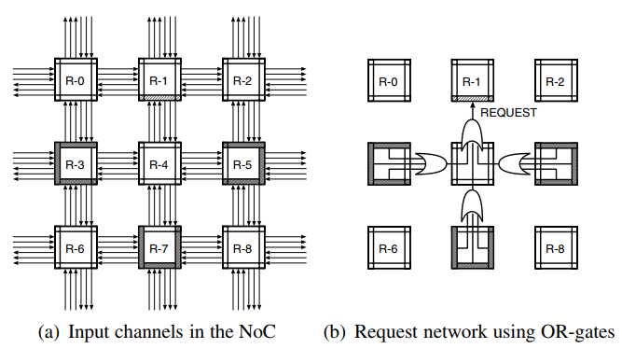
Look-Ahead Sleep Control
Call South channel of router 1 is “target”. The target channel monitor request signal from input channel in router 3, 5, 7 to make decision.
The colored input channel assert their request signal for the target channel when packet destined for router 1.
Critical path twice long, so can using 2 clock cycle to transfer for target channel

Slide 10
Outline
On-Chip Router
Architecture
Power consumption
Runtime power gating of routers
Overheads
Look-Ahead sleep control
Evaluations
Performance penalty
Leakage reduction

Slide 11
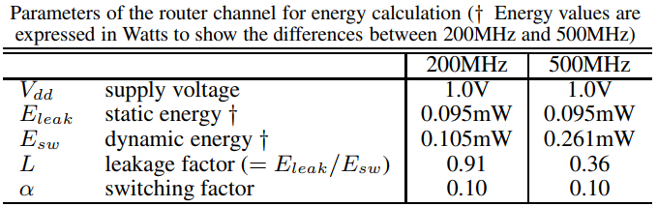
Evaluations: Simulation
Environment
Synopsys Power Compiler 90nm

Slide 12
Evaluations: Sleep control methods
Evaluation items
Network throughput
Leakage reduction
Parameters
Ideal method
Ideal case
No wakeup delay
Look-ahead method
Detects packet arrival 5-cycles ahead
Naïve method
No look-ahead
Topology | 2-D Mesh (4x4)
Routing | DOR (XY routing)
Packet size | 5-flit (1-flit header)
Buffer size | 4-flit (WH switching)
# of VCs | 2 VCs
Latency | 3-cycle per 1-hop

Slide 13
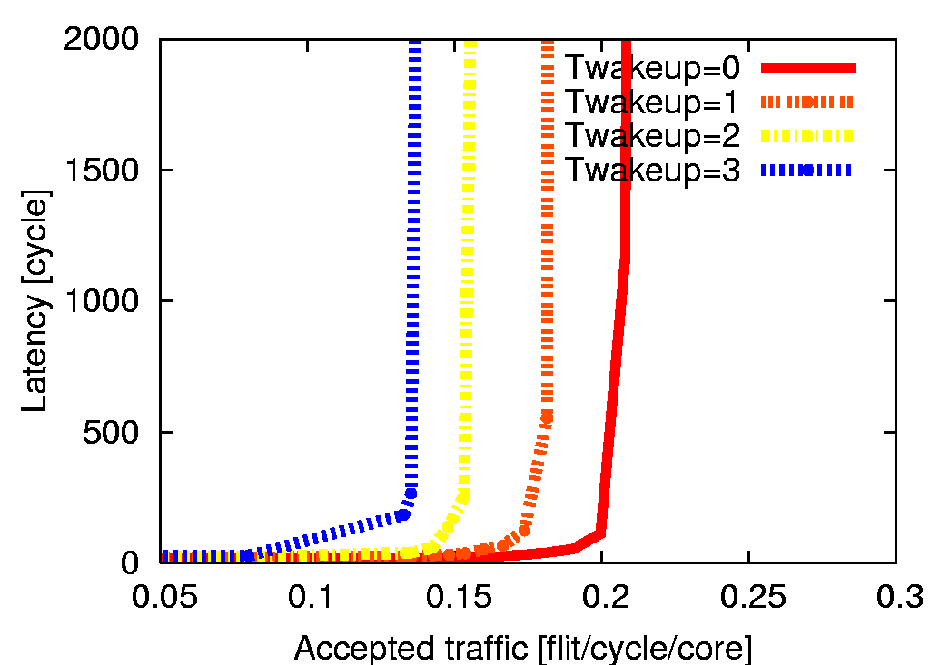
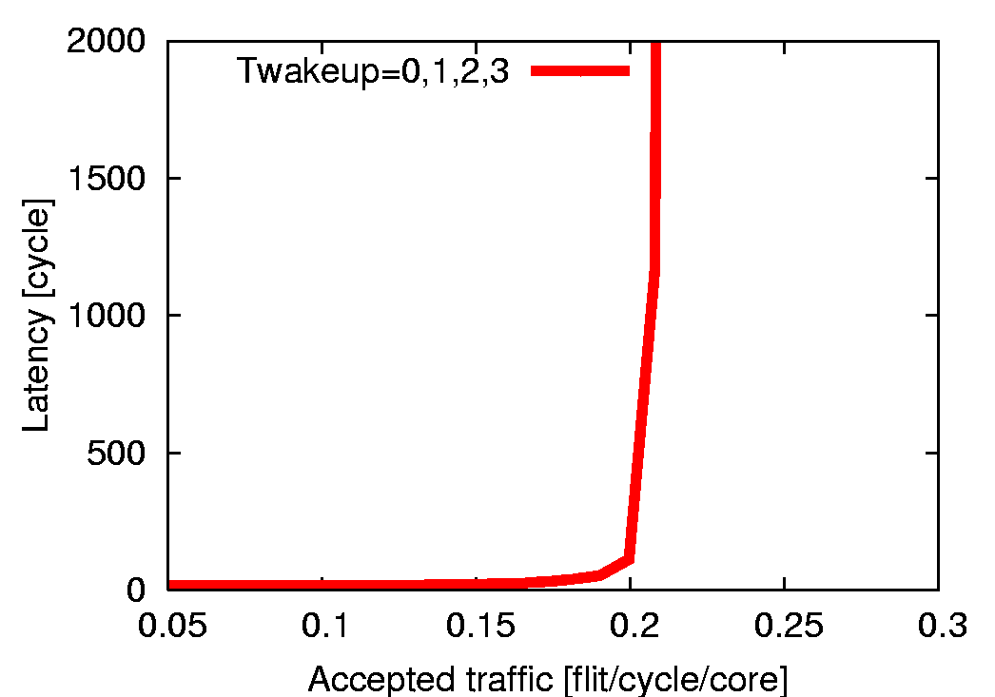
Evaluations: Performance of “lookahead”
Throughput on various wakeup delays (e.g., 0,1,2,3 cycles)
Naive: Performance is degraded as Twakeup increases
Ideal: Same
Look-ahead: Same if Twakeup is less than 5

Slide 14
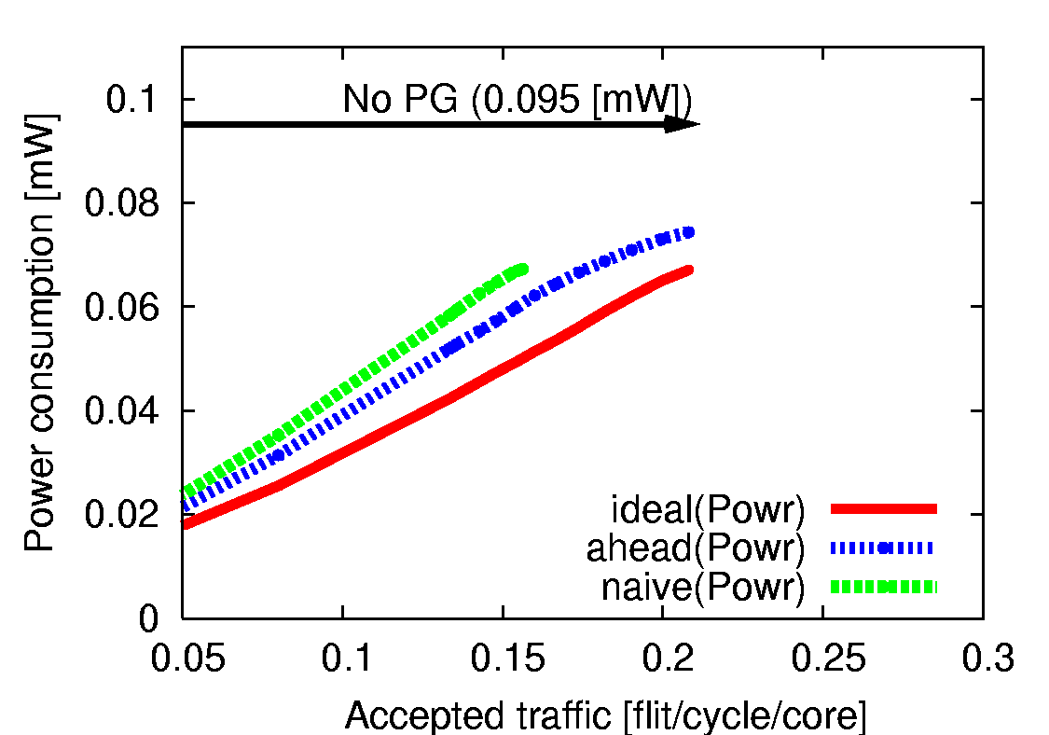
Evaluations: Leakage power reduction
Leakage power at each channel Tbreakeven = 6
No power gating consumes 95 [uW]
Leakage reduction of PG with 3 sleep control methods
- Leak increases as traffic increases
=> Ideal <Look-ahead < Naive
Leakage reduction
Uniform traffic (16-core)

Slide 15
Summary: Look-ahead sleep control
Runtime power gating of router channels
Wakeup delay introduces pipeline stalls of routers
Short-term sleeps overwhelm the leakage reduction
Look-ahead sleep control
An extension of “look-ahead routing”
Detects the arrival of packets five cycles ahead
Evaluation results
Look-ahead conceals the wakeup delay of less than 5
Look-ahead reduces more leakage compared with naive

Slide 16
Thank you for your attention

Slide 17
Backup slides

Slide 18
Look-ahead method: HW resources
Routing computation of next router
Just changing the routing function
Area overhead is very small
Wakeup signals are needed
Sender asserts “wakeup” signal
to receiver
Wakeup signals becomes long
Negative impact of
multi-cycle or repeater buffers
NRC stage: Next Routing Computation
HEAD
NRC
SA
ST
NRC
SA
ST
NRC
SA
ST
DATA 1
ST
ST
ST
DATA 2
ST
ST
ST
0
1
2
3
4
5
6
7
8
Wakeup signals to router 1

Slide 19
Look-ahead method: the 1st hop?
Look-ahead for Router 3, Router 4, Router 5, …
Look-ahead for Router 1 and Router 2
Network interface (NI) performs look-ahead
Packet construction takes several clock cycles
NI of source node can perform “look-ahead”
Look-ahead!!
Look-ahead!!
Src
Router (1)
Router (2)
Router (3)
Router (4)
Dst
Look-ahead!!
Src
Router (1)
Router (2)
Router (3)
Router (4)
Dst

